Slide 1
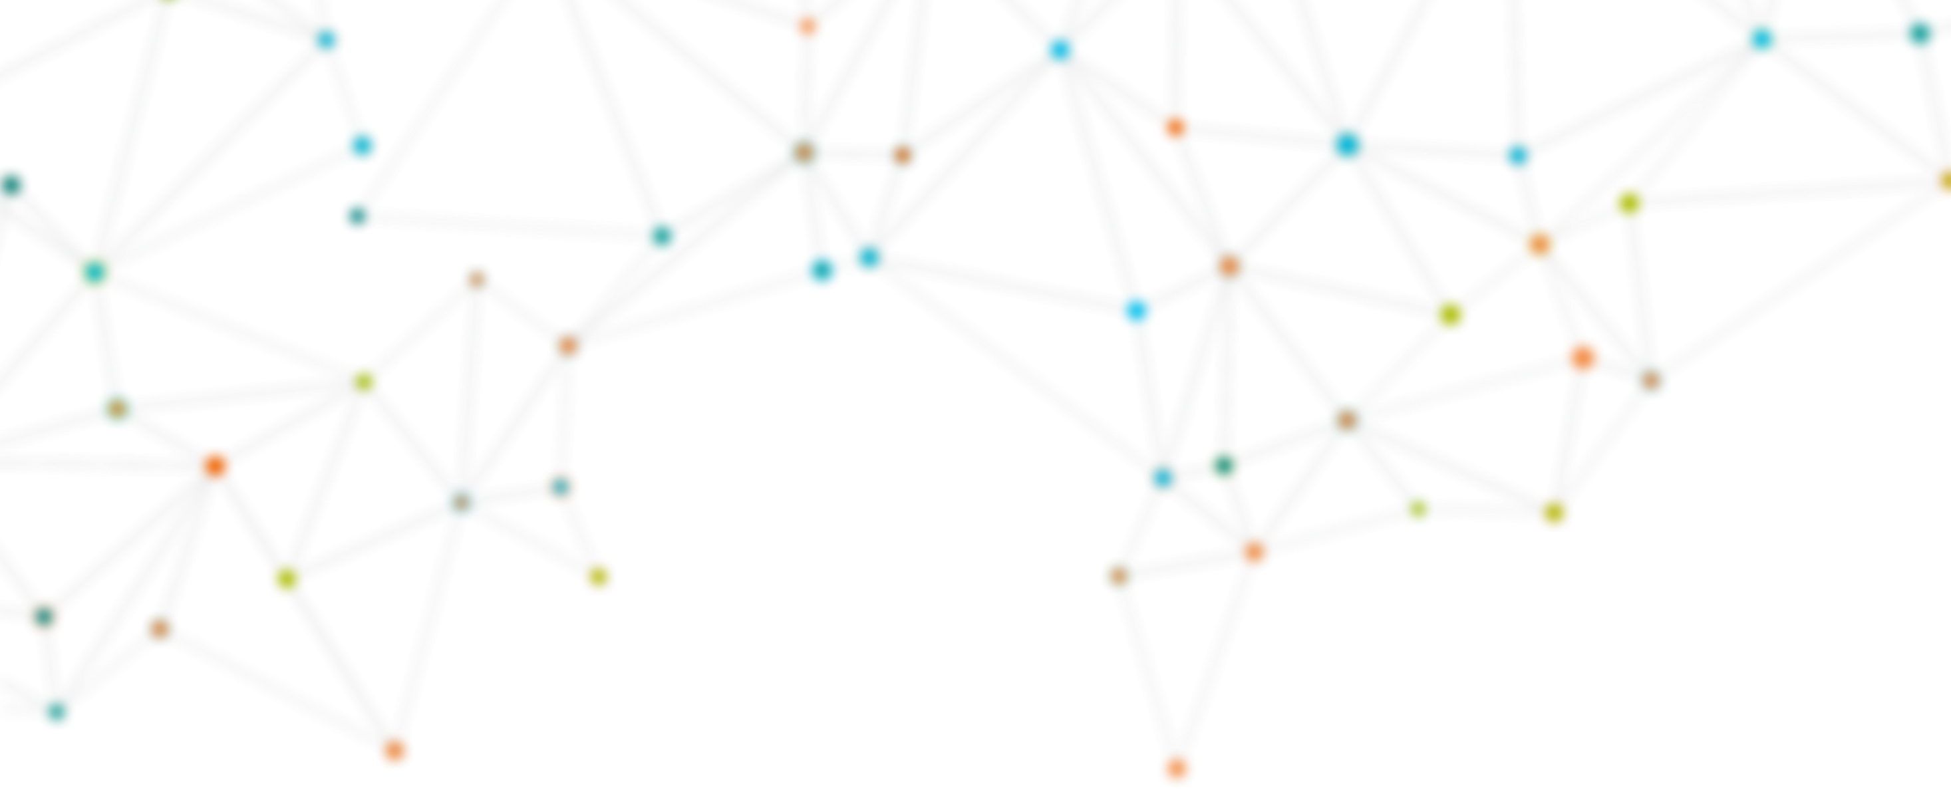






A closer look at MiraMon Map Browser
OGC Tiling Interfaces Code Sprint 2023 Saint Louis (Missouri)
Núria Julià Selvas (CREAF) n.julia@creaf.uab.cat
12 June 2023
Funded by the European Union. Views and opinions expressed are however those of the author(s) only and do not necessarily reflect those of the European Union or the European Research Executive Agency (REA). Neither the European Union nor the granting authority can be held responsible for them.

Slide 2
MiraMon Map Browser
The MiraMon Map Browser is a long term developing effort to create visualization, metadata, analysis and download tools that runs on web browsers.
Only based on HTML5 and JavaScript, it uses Open Geospatial Consortium web service protocols and APIs to connect to web services and show the data to the user in a map format.
The JavaScript client is able to combine AJAX, binary arrays with several web services and web APIs including WMS, WMTS protocol and OGC API Maps and Tiles.

Slide 3

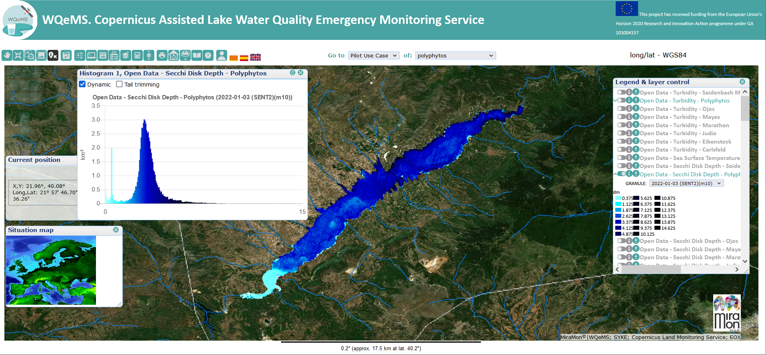
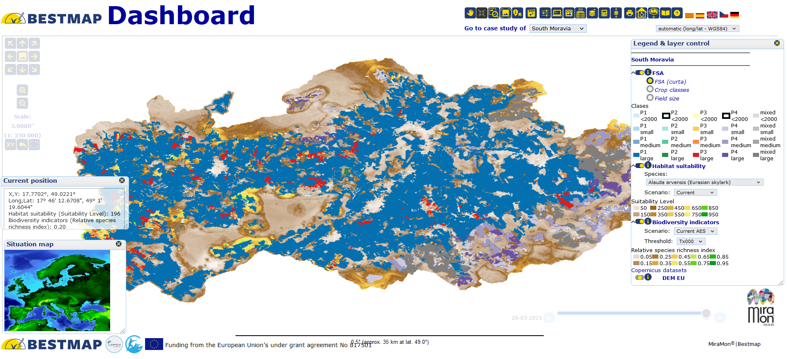

www.citiobs.eu
Web Page
https://www.miramon.cat/USA/Prod-NavegadorServidor.htm#MiraMonMapBrowser
Github repository
https://github.com/grumets/MiraMonMapBrowser
Some web Browsers
https://www.ogc3.grumets.cat/wqems
https://www.ogc.grumets.cat/bestmap

Slide 4
Main differentiation features of MiraMon's Map Browser

Slide 5
Creating a web browser without coding
You don’t have to code anything to create a MiraMon Map browser
A JSON configuration file (config.json) control all the elements of the web browser:
Position of the view, situation map, legend…
Services and layers, COG images, GeoJSON files included in the web browser
Characteristics of the layers:
Symbolization
Download
Metadata and quality
This is the main difference between others client implementations such as OpenLayers and LeftLet, that’s requires some knowledge of JavaScript to create the map browser

Slide 6
Symbolizing and analyzing on the client side
The objective of the development is to assign to the web browser and the JavaScript engine as much work as possible, limiting interactions to the server the minimum possible and the transfer of information to a format that is as raw as possible.
This approach can be surprising these days when many applications prefer to perform processing functionalities in the cloud and not in the client machine.
Most of the time, the MiraMon Map Browser is the direct responsible to create the visualization on the fly based on the raw data, allowing the user to change visualization properties, perform analysis, statistics or build time series in the client side directly.

Slide 7
Some characteristics and functionalities
www.citiobs.eu
Raster visualization and query by location using OGC Web Map Service (WMS), Web Map Tiled Service (WMTS) and OGC Web APIs
Vector visualization and query by location using OGC Web Feature Service (WFS), Sensor Observation Service (SOS), Sensor Things API (STA) and STA+
Direct visualization of GeoJSON and Cloud Optimized GeoTIFF (COG) from the Internet or a local drive
Raster analytics using OGC WMS and binary arrays of values, instead of pictorial representations, and COGs
Pixel based analysis is performed directly in JavaScript in the client side and visualized on the fly
Downloads using Web Coverage Service (WCS)
Metadata, quality and uncertainty computation

Slide 8
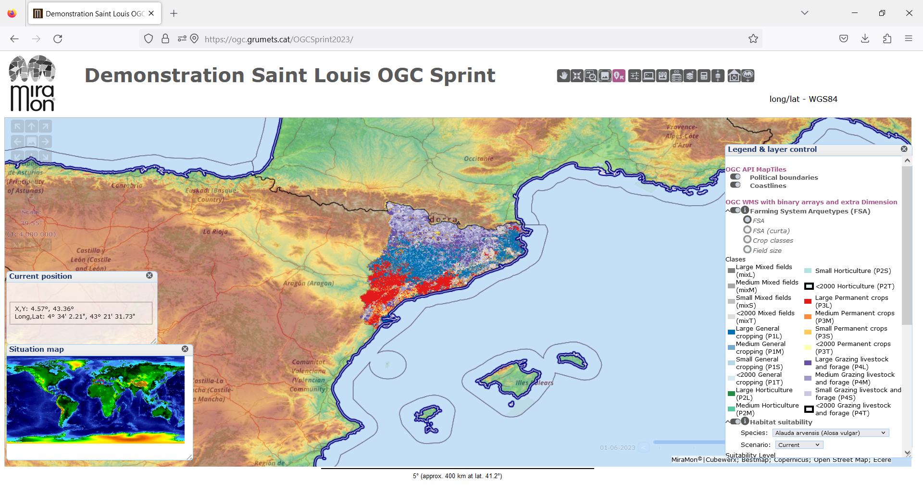
https://ogc.grumets.cat/OGCSprint2023/

Slide 9
Use of the MiraMon Map Browser console and the Developer editor network tool to illustrate how the client side dialogues with Web services and Web APIs

Slide 10
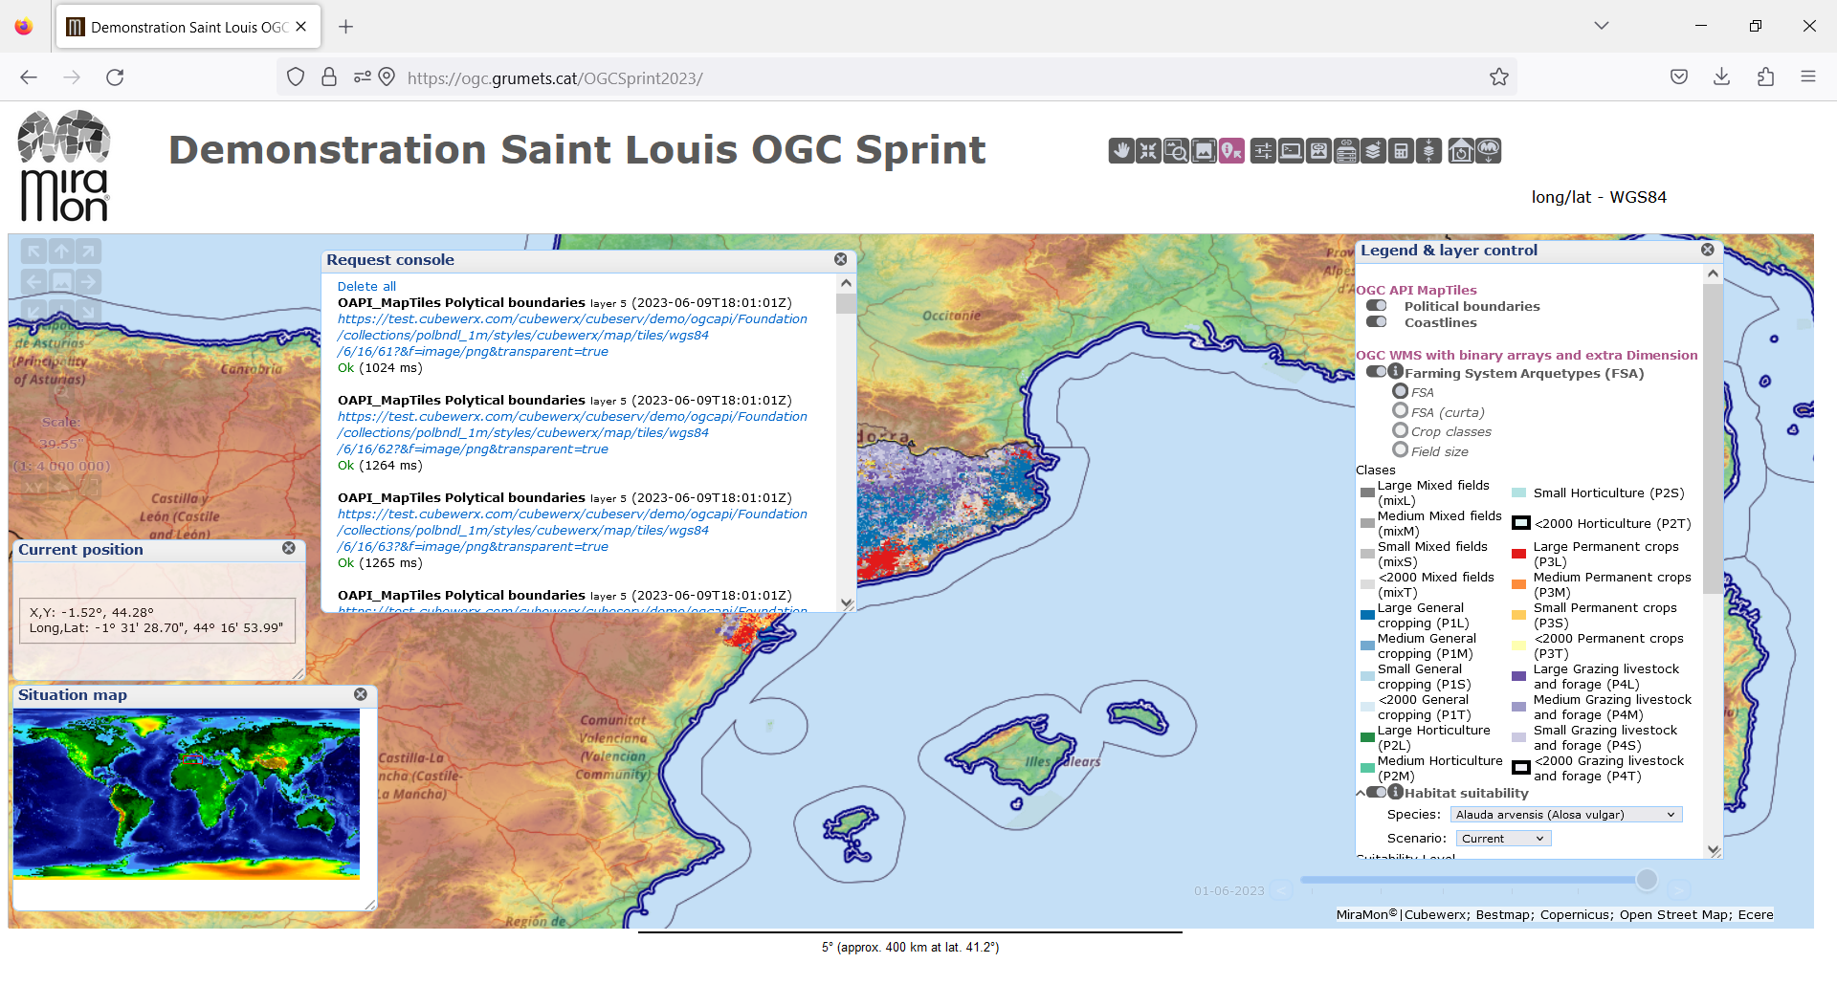

Slide 11
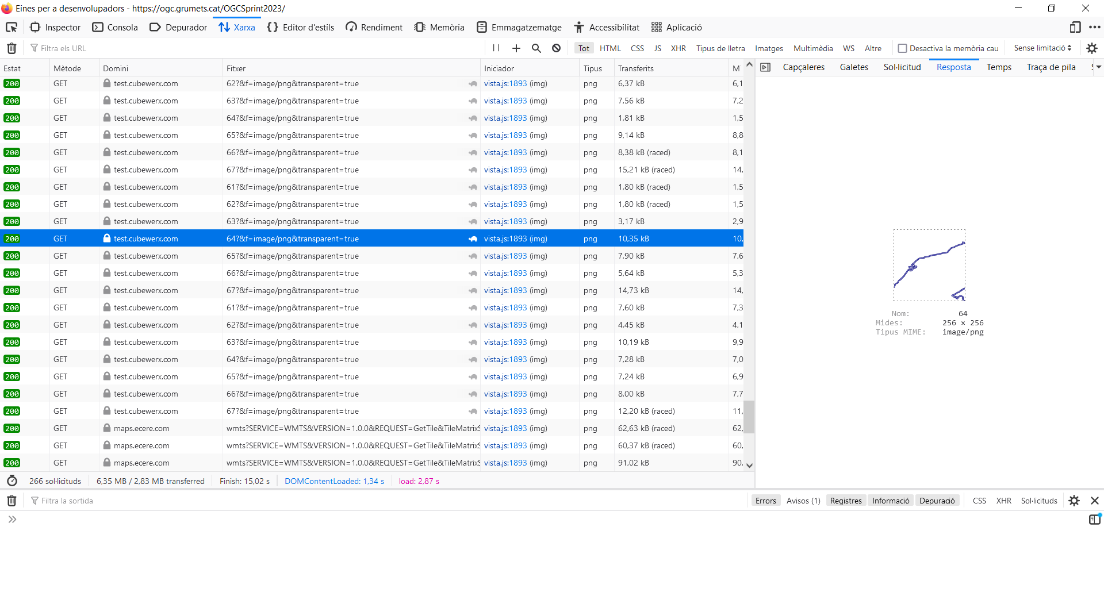

Slide 12
Illustrate the combination of web services, web APIs and direct file and objects access.

Slide 13
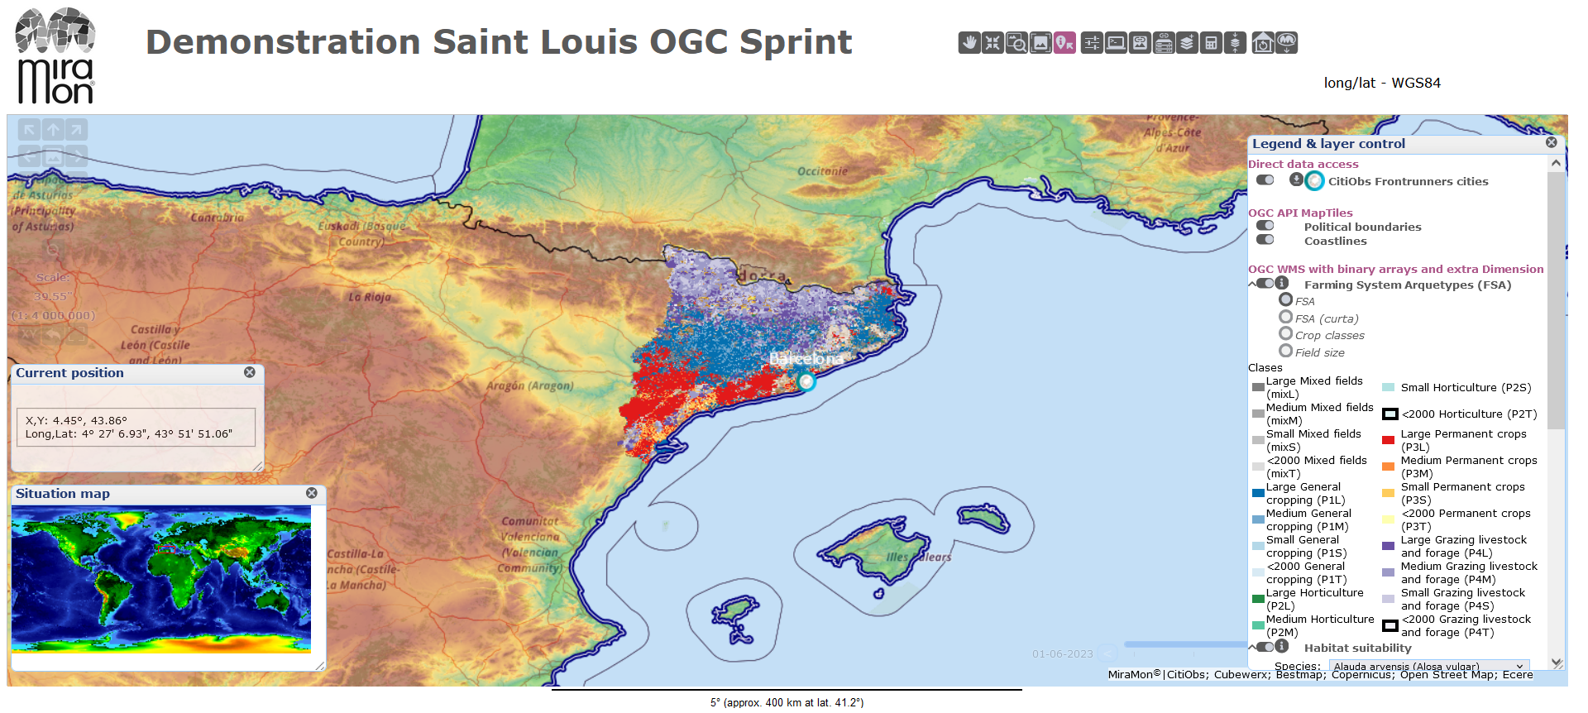

Slide 14
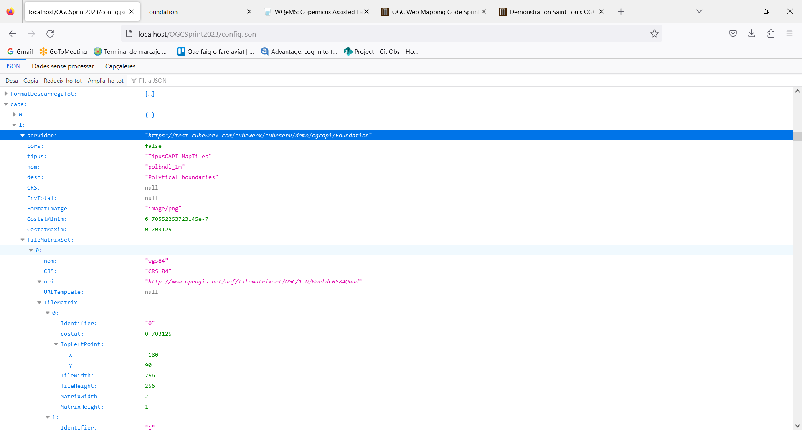
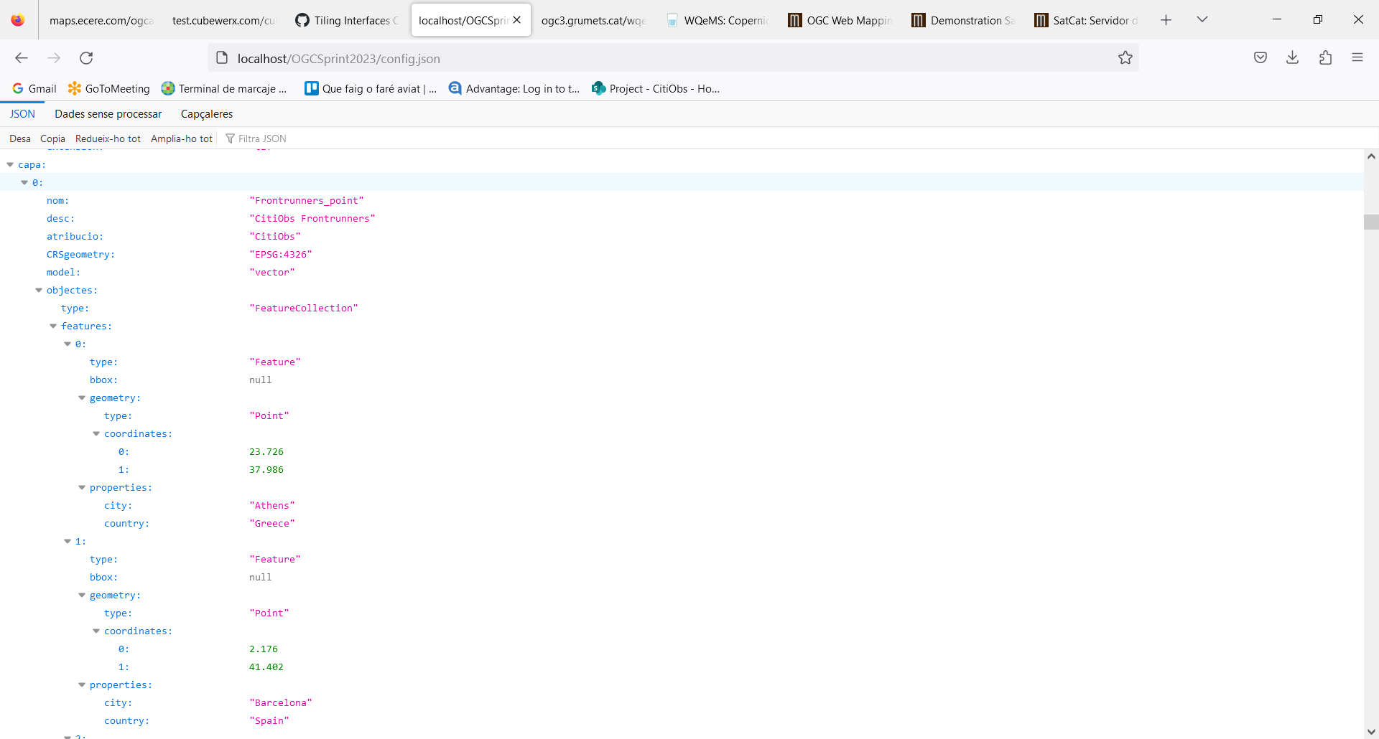

Slide 15
How to add new services and layers.

Slide 16
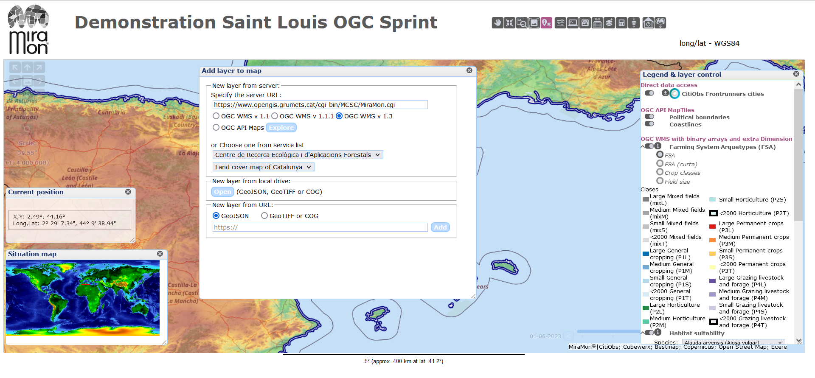

Slide 17
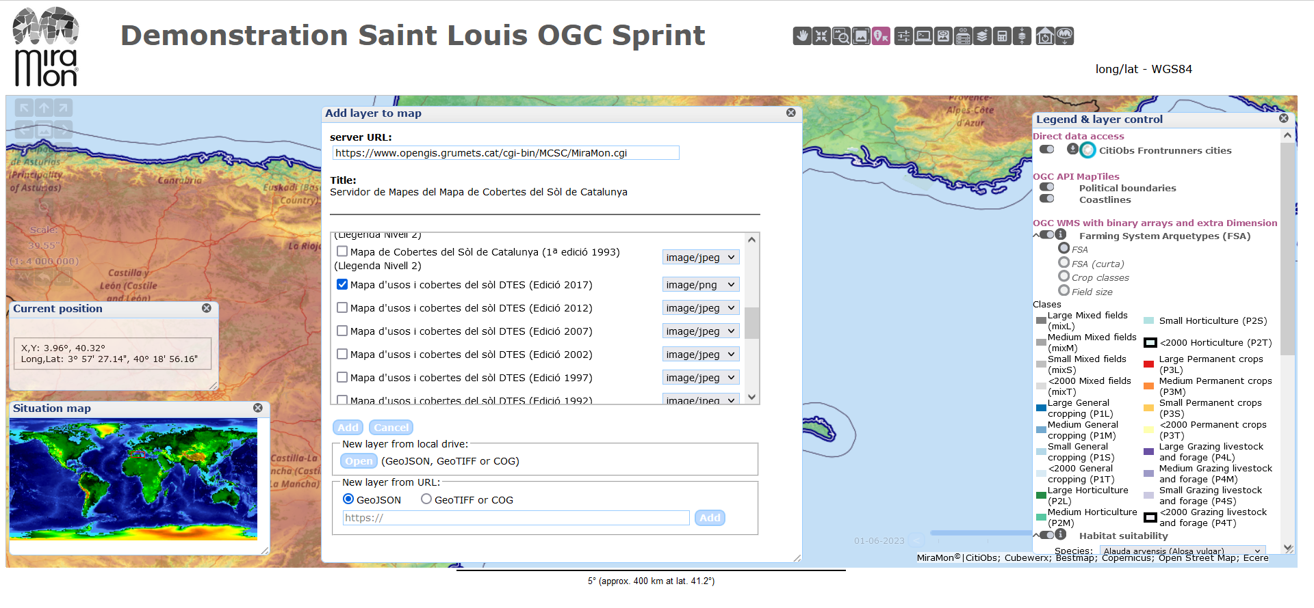

Slide 18
How to use canvas and binary arrays to play with raster data.

Slide 19
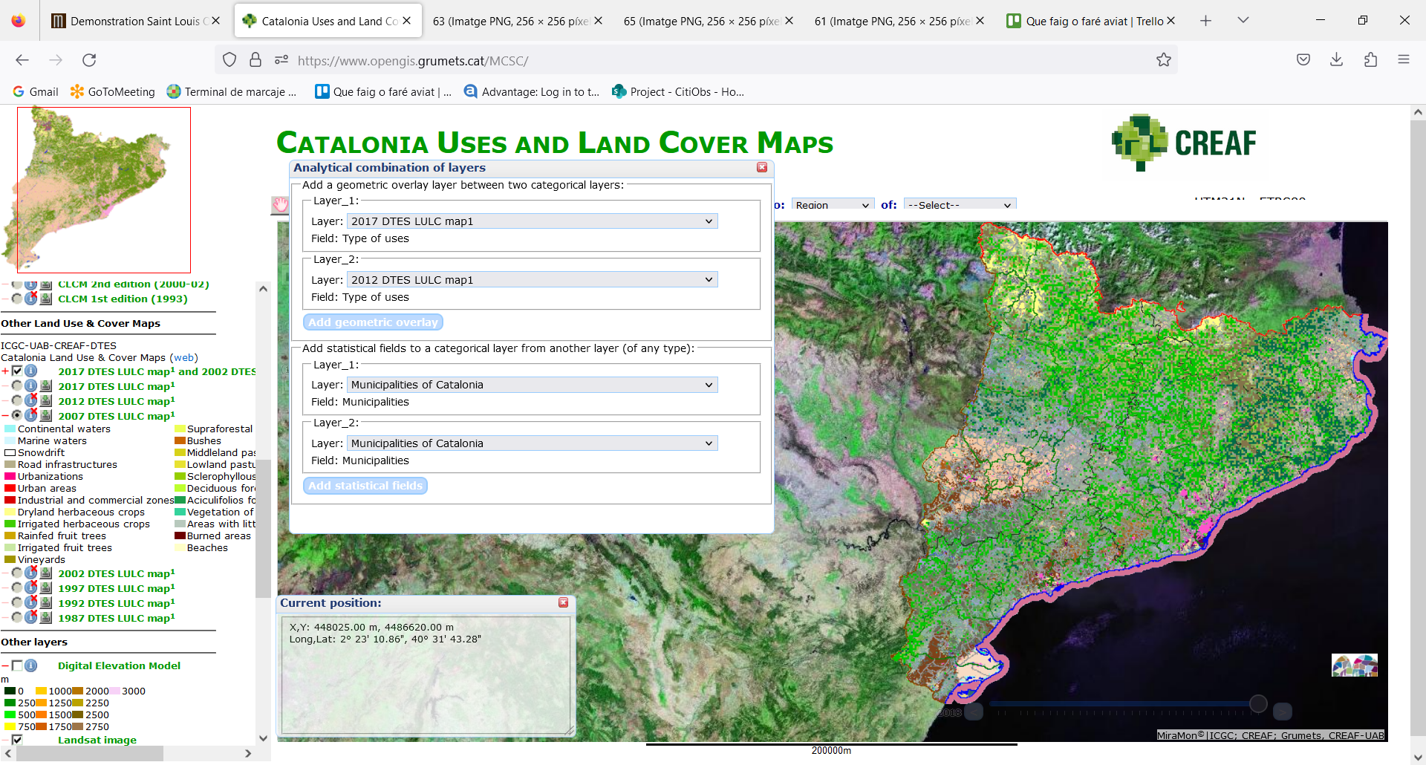

Slide 20
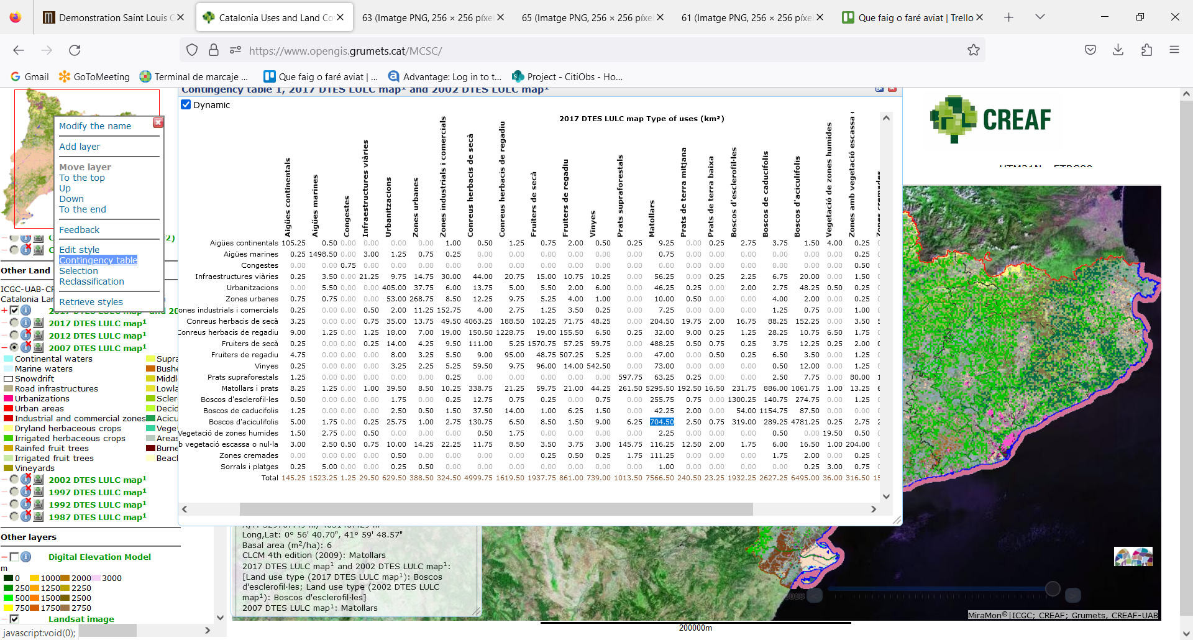

Slide 21
Thank you!
Núria Julià
Funded by the European Union. Views and opinions expressed are however those of the author(s) only and do not necessarily reflect those of the European Union or the European Research Executive Agency (REA). Neither the European Union nor the granting authority can be held responsible for them.

